Slide 1
Project Oasis Technical Design
By Joshua Bissell

Slide 2
Core Mechanics
The game will be a sci-fi hack ‘n slash so the core mechanics for the project are:
Top-down Camera System
Melee and Ranged Combat
Quests
NPC Dialogue
Inventory

Slide 3
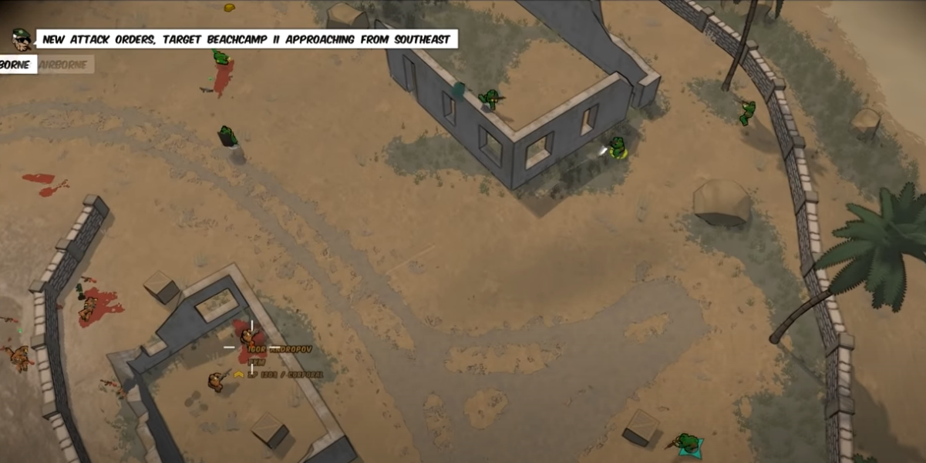
Top-down Camera System
The design of the top-down camera system is taken from a game named Running with Rifles, when you move the mouse it pans the camera so that it is between the player and the mouse, which creates a nice view effect, I managed to recreate this in Unity using the new Input System.

Slide 4
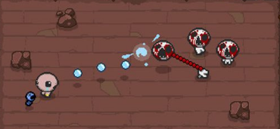
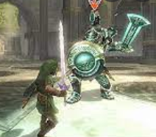
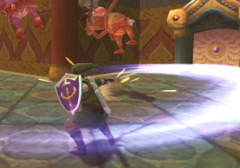
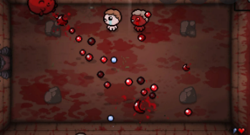
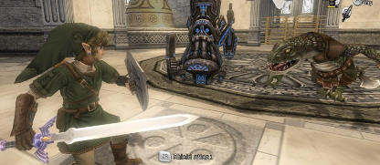
Melee and Ranged Combat
The combat system needs to be quicker and more cartoonish for a hack ‘n slash, for this we can take inspiration from games such as the Binding of Isaac and The Legend of Zelda
The melee attacks need to be fast and on a cooldown, with critical strikes at random that will hit for more damage.
The ranged attacks need to also be fast and precise, they should be easy to track.

Slide 5
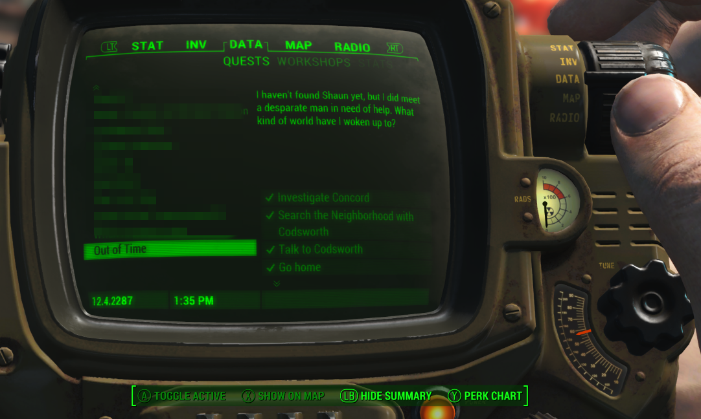
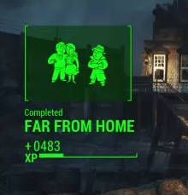
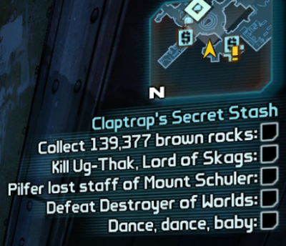
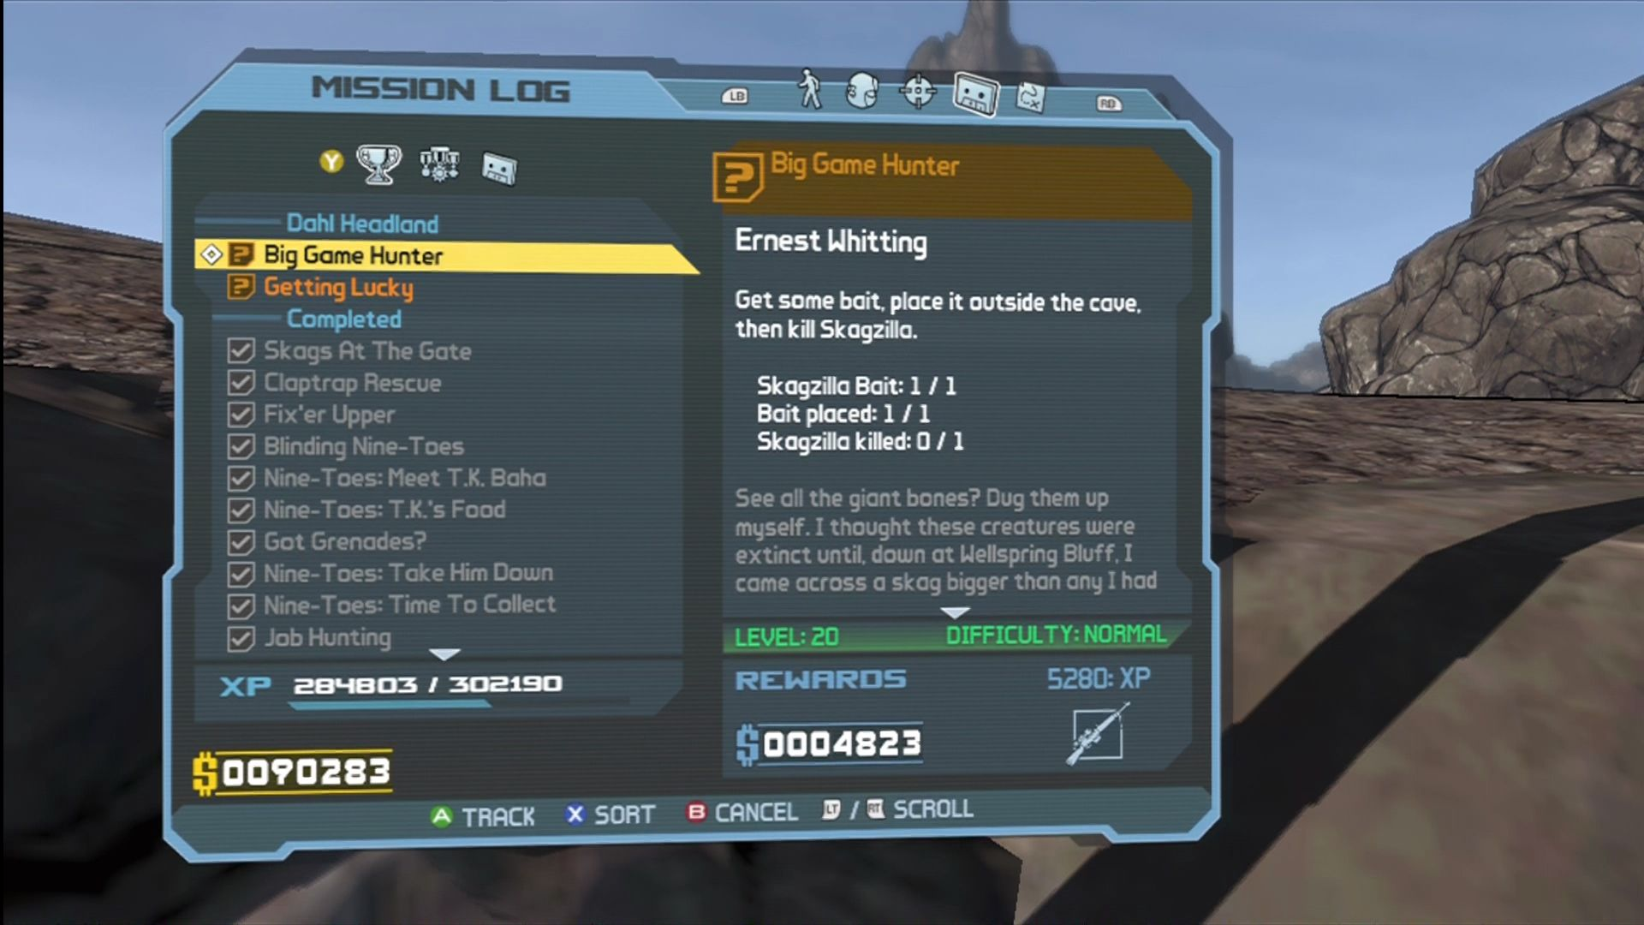
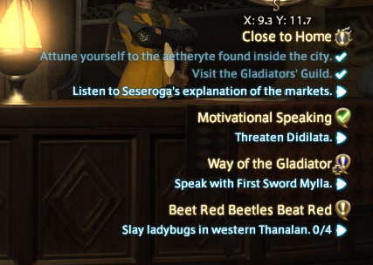
Quests
The quest system must be easy to follow but provide objectives for players to follow, so that they know what to do in the game, one good example of a quest system with quest boards is the Borderlands series, more good examples include: Fallout 4; World of Warcraft; and Final Fantasy

Slide 6
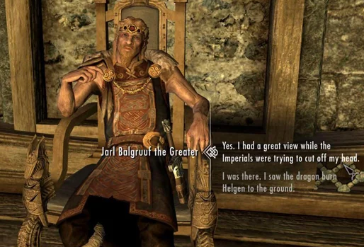
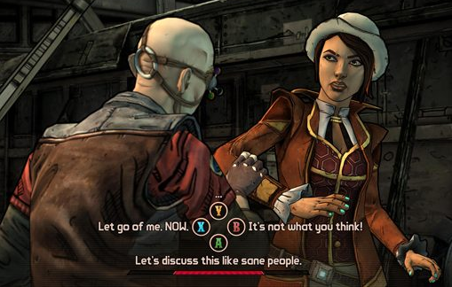
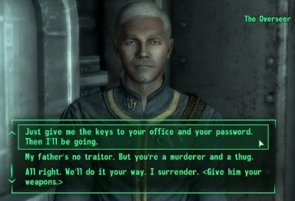
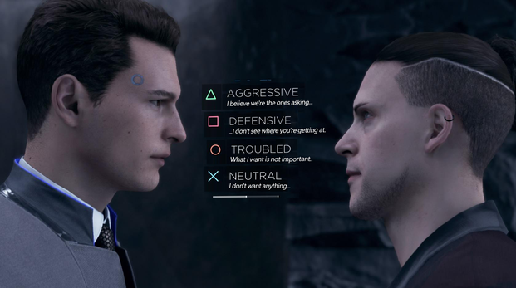
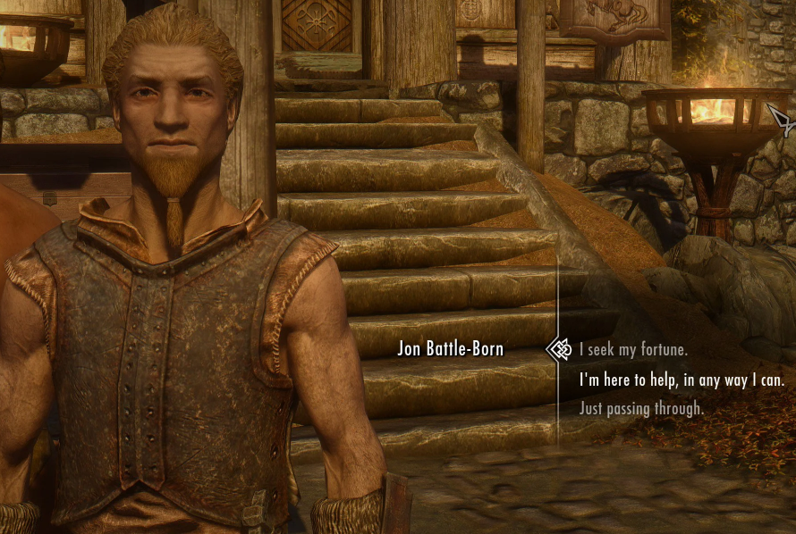
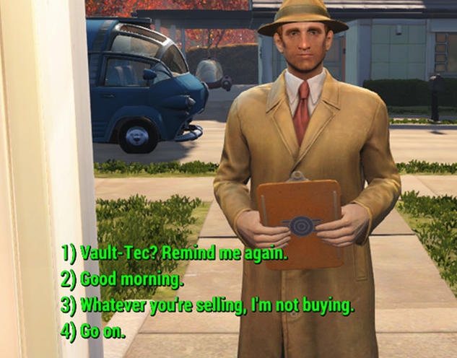
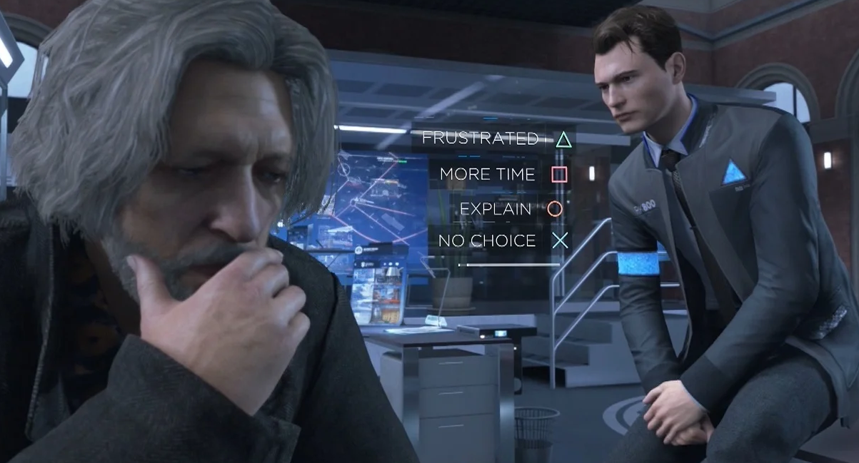
NPC Dialogue
NPC Dialogue will be an important part of the game as it will tell the story of the game as well as guiding the player through the game, unlocking quests and making decisions throughout their playtime. Good examples of NPC dialogue systems include titles such as Borderlands, Fallout, Detroit Become Human and Skyrim.

Slide 7
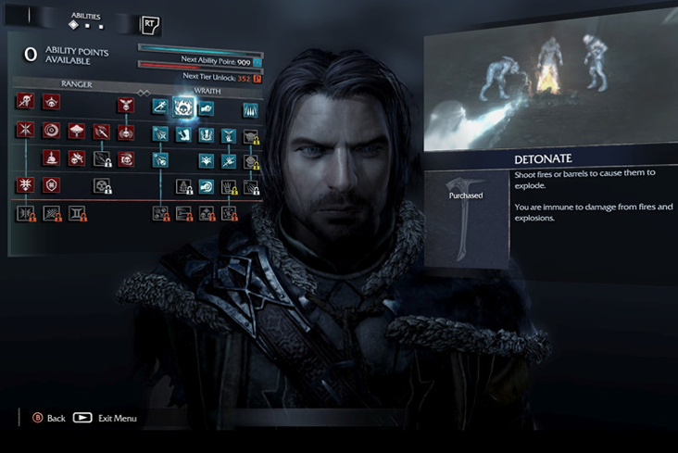
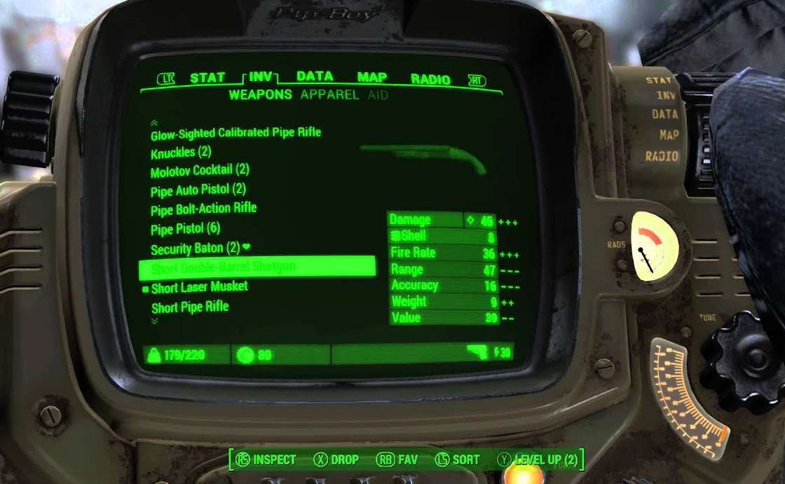
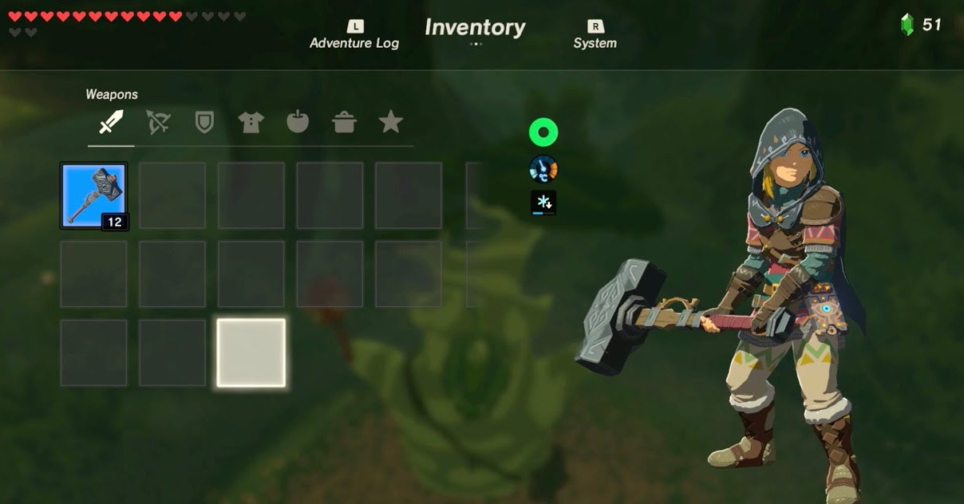
Inventory
The Inventory system is a core mechanic of multiple hack ‘n slash type games like The Legend of Zelda and Shadow of Mordor, there's multiple ways to go about handling the inventory UI, it needs to be easy to navigate and read.

